Slide 1
Lecture 6 Unsupervised Learning
CS582
Machine Learning: Getting Computers
to Program Themselves
“Discovering the Learning Dynamics of the Laws of Nature”
Dr. Emdad Khan
ekhan@iu.edu
Prof. of Computer Science
Maharishi International University

Slide 2
Unsupervised Learning Basics - 1
So far we have seen training set with labelled target data.
However, targets may not always be available (Manual process for many cases, more – next slides).
Unsupervised Learning is the learning where no labelled targets are available i.e. the learning is not supervised.
Input training data is used to find similarities between various input data and then group those into some appropriate groups or clusters.

Slide 3
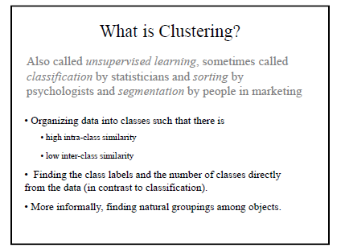
Unsupervised Learning Basics – Clustering -1
.

Slide 4
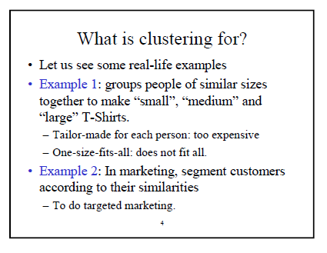
Unsupervised Learning Basics – Clustering -2
.

Slide 5
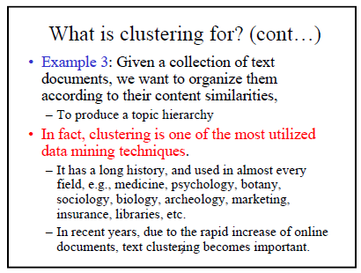
Unsupervised Learning Basics – Clustering -3
.

Slide 6
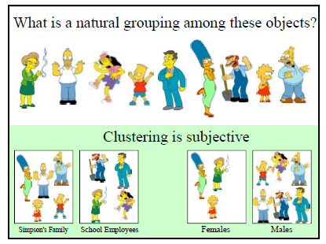
Clustering is Subjective
.

Slide 7
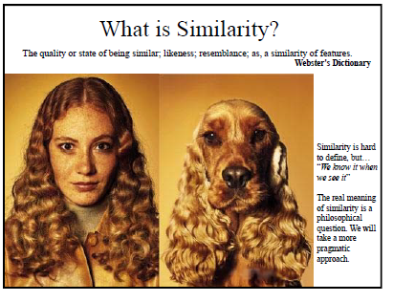
Similarity: Hard to Define
.

Slide 8
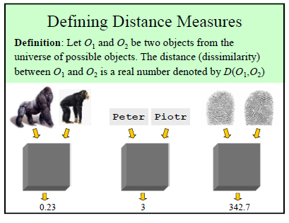
Distance Measure
.

Slide 9
Some Highlights for Unsupervised Learning
Obviously we cannot do any regression as there is no desired output.
We need new error criteria.
We would need new learning algorithms.
We would need different architecture.

Slide 10
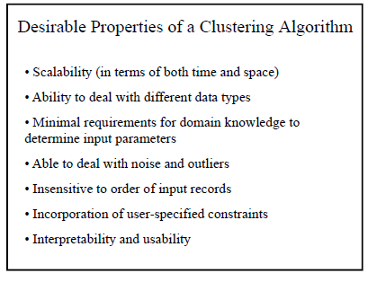
Desirable Properties of Clustering Algorithms
.

Slide 11
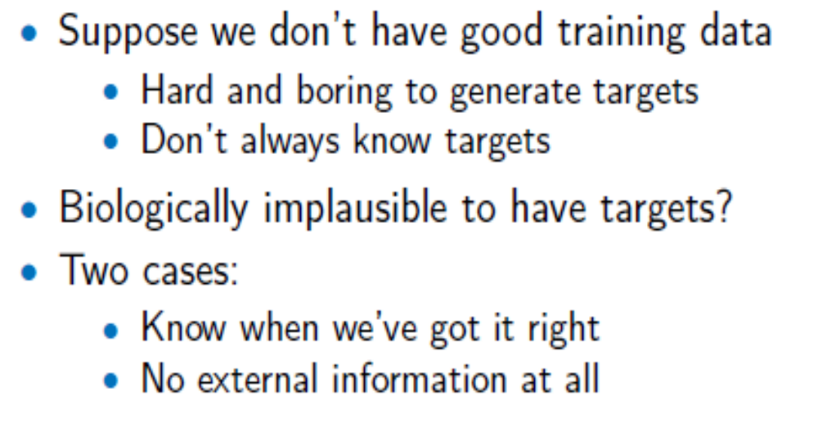
Issues with Target Data - 1

Slide 12
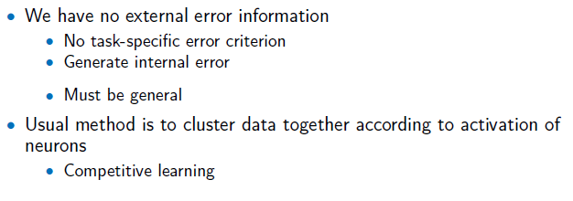
Issues with Target Data - 2

Slide 13
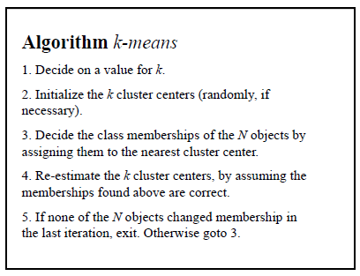
K-Means Algorithm
.

Slide 14

K-Means Algorithm
    for each datapoint x_{i}:
      compute the distance to each cluster centre
      assign the data point to the nearest cluster centre with distance
    for each cluster center:
      ·move the position of the centre to the mean of the points in that cluster (N_{j} is the number of points in cluster j)
.

Slide 15
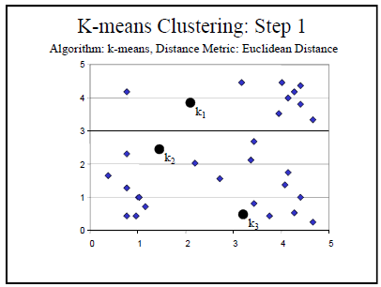
K-Means Clustering Steps - 1

Slide 16
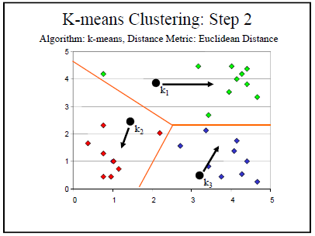
K-Means Clustering Steps - 2

Slide 17
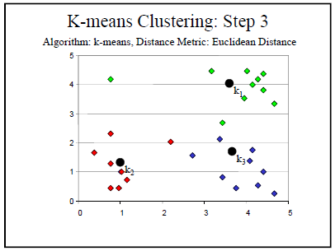
K-Means Clustering Steps - 3

Slide 18
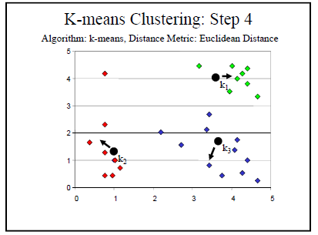
K-Means Clustering Steps - 4

Slide 19
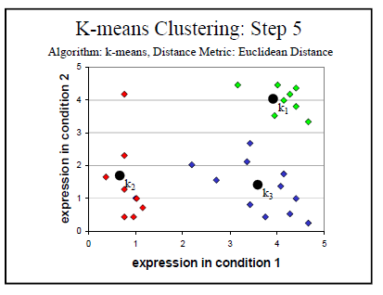
K-Means Clustering Steps - 5

Slide 20
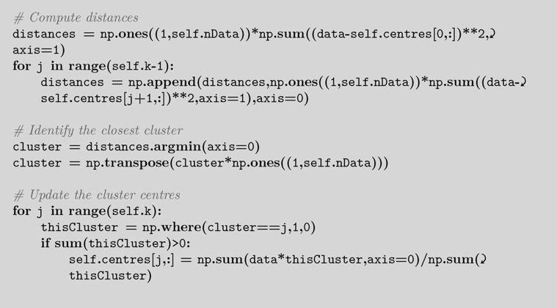
K-Means Algorithm - Python
.

Slide 21
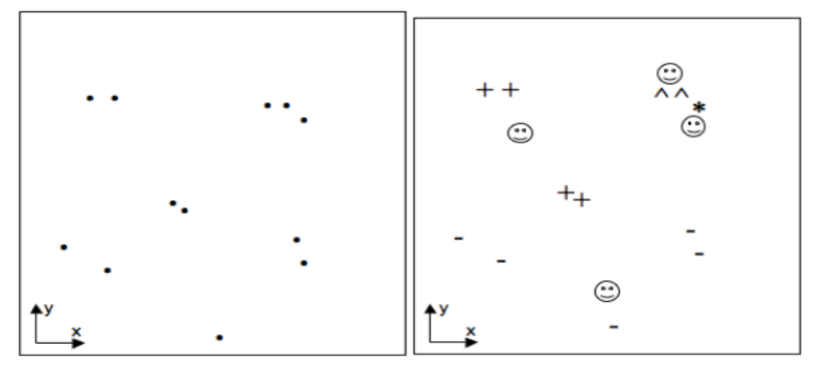
Clustering Results - 1
FIGURE 14.1 Left: A two-dimensional dataset Right: One possible ways to position 4 centers (drawn as faces) using the k-means algorithm, which is clearly susceptible to local minima.
.

Slide 22
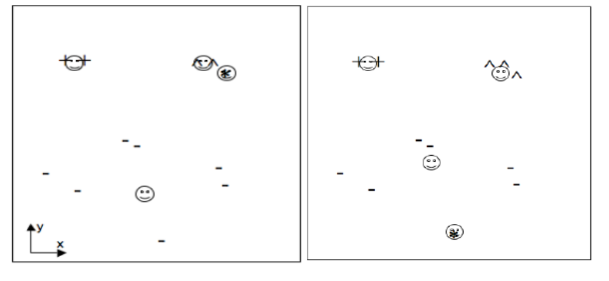
Clustering Results - 2
FIGURE 14.1 (contd.) Two other possible ways to position 4 centers (drawn as faces) using the k-means algorithm, which is clearly susceptible to local minima.
.

Slide 23
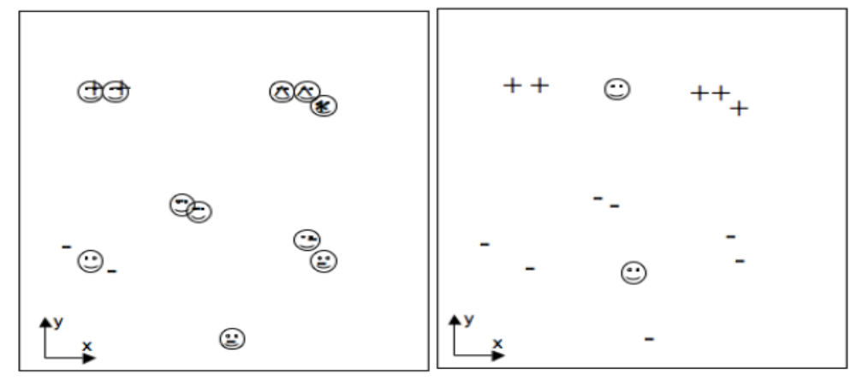
Clustering Results - 3
FIGURE 14.2 Right: A solution with only 2 classes, which does not match the data well. Left: A solution with 11 classes, showing severe overfitting.
.

Slide 24
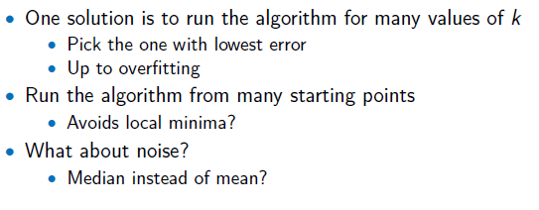
K-Means Algorithm - Options
.

Slide 25
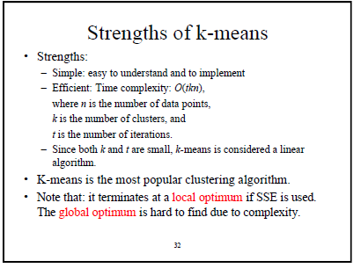
K-Means Algorithm - Advantages
.

Slide 26
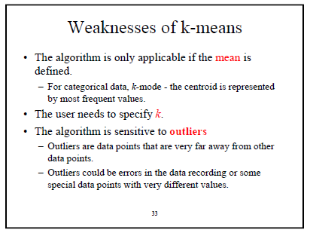
K-Means Algorithm – Disadvantages
.

Slide 27
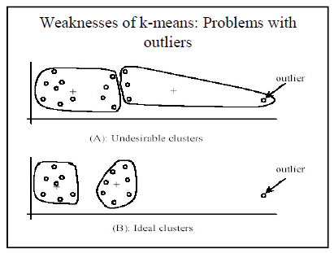
K-Means Algorithm – Disadvantages - 3
.

Slide 28
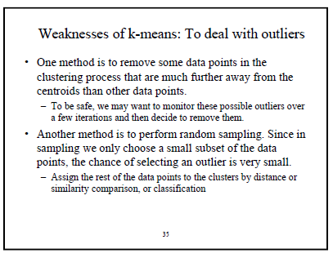
K-Means Algorithm – Disadvantages - 4
Sensitive to Initial Values (have seen this in the results shown before)

Slide 29
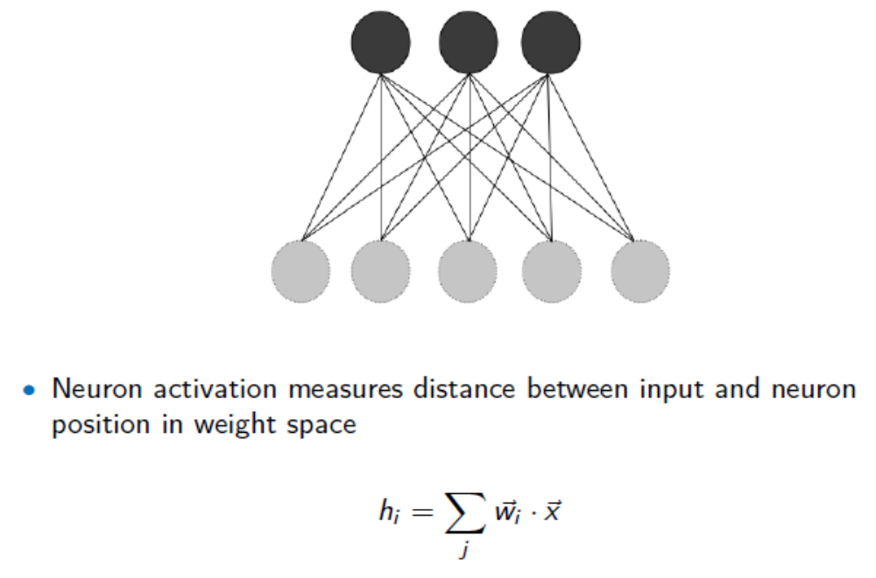
K-Means Neural Networks
.

Slide 30
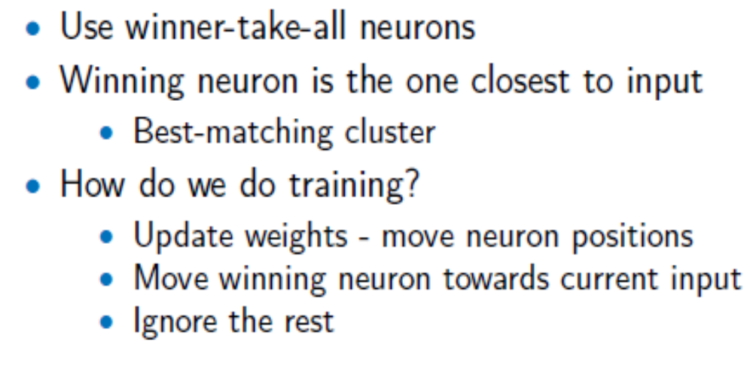
K-Means Neural Networks
.

Slide 31
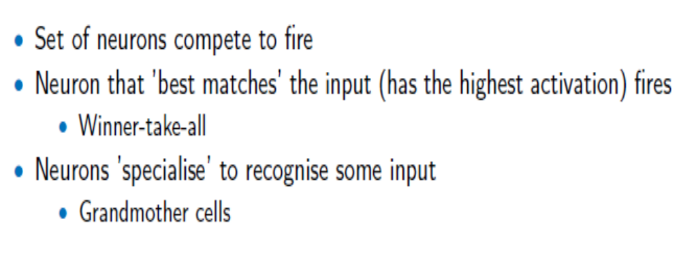
Competitive Learning

Slide 32
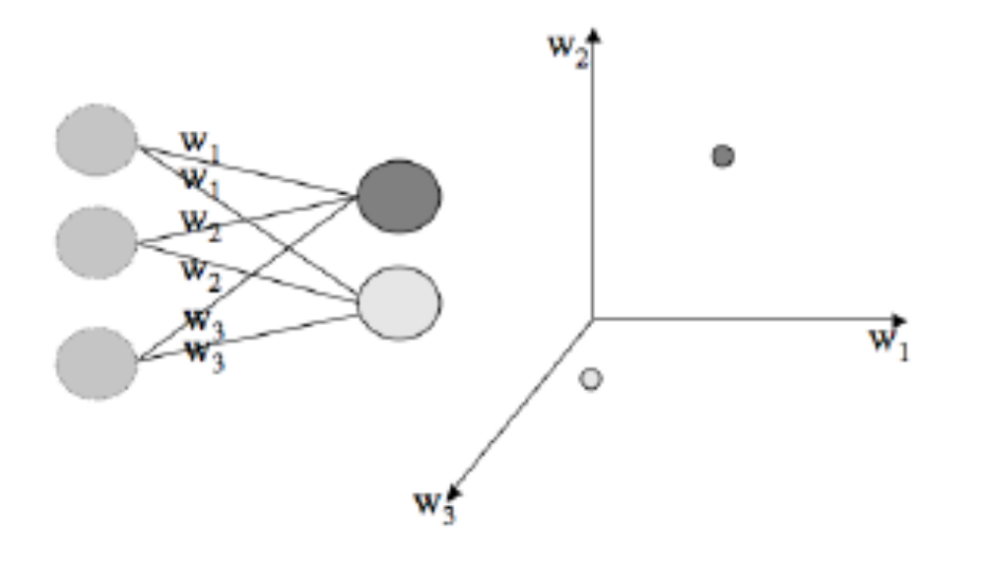
Weight Space
Plot Neurons positions according their weights.
This helps better understand neurons distances / positions with respect to their weights.

Slide 33
Normalization-1
Suppose weights to all neurons are small except those to one particular neuron (3rd neuron with weights 10 – next page).
Assume an input vector(0.2, 0.2, -0.1)
Next slide

Slide 34
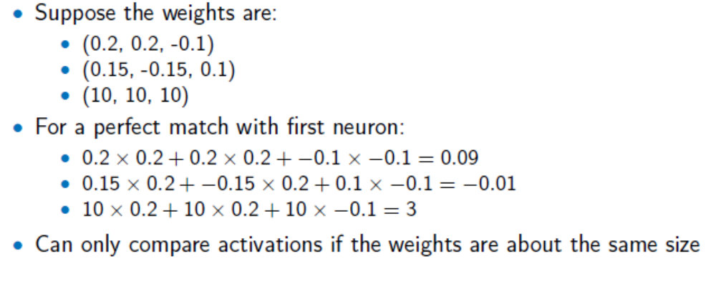
Normalization
While neuron 1 (first row) should be the winner, the 3rd neuron wins as it has weights 10. This shows that we need to scale all weights to similar values as otherwise, results will be incorrect.

Slide 35
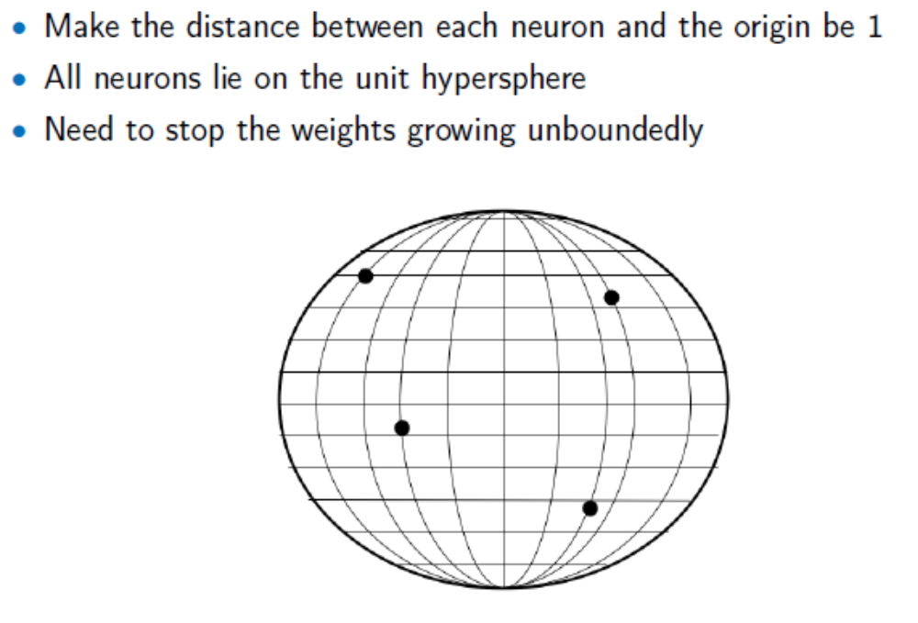
Normalization

Slide 36
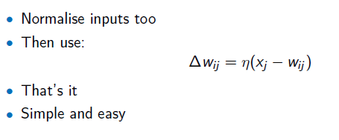
Learning Equation

Slide 37
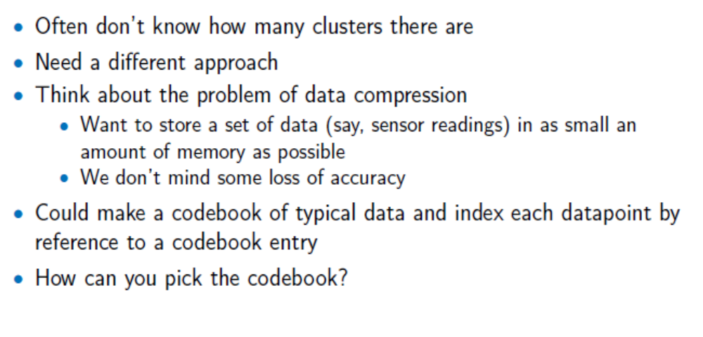
Vector Quantization as an Application

Slide 38
Vector Quantization as an Application
If the input vector matches the codebook (i.e. the index), just pick that from the codebook.
If no match to any codebook index, then use some method to find the closest codebook index. This is called Vector Quantization.
Learning this is called Vector Quantization Learning.
Clustering / Competitive Learning becomes handy for Vector Quantization learning.

Slide 39
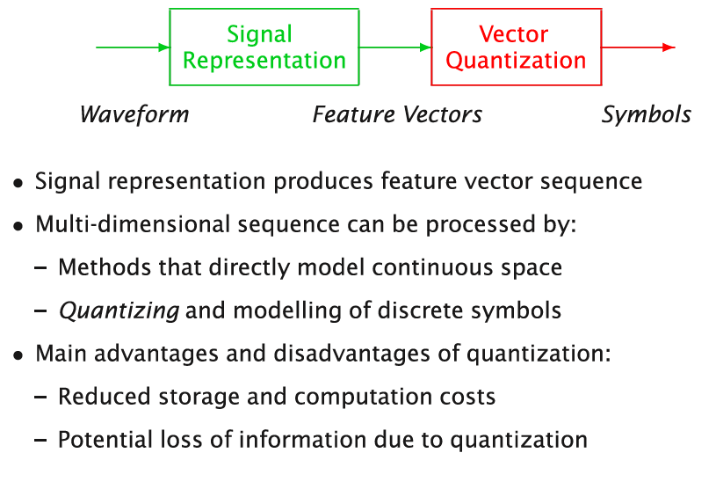
Vector Quantization in Speech Recognition - 1
Signals from a microphone is a continuous signal that carry all key features.
Such features (e.g. MFCC – Mel frequency spectral coefficients) needs to be extracted and digitized.

Slide 40
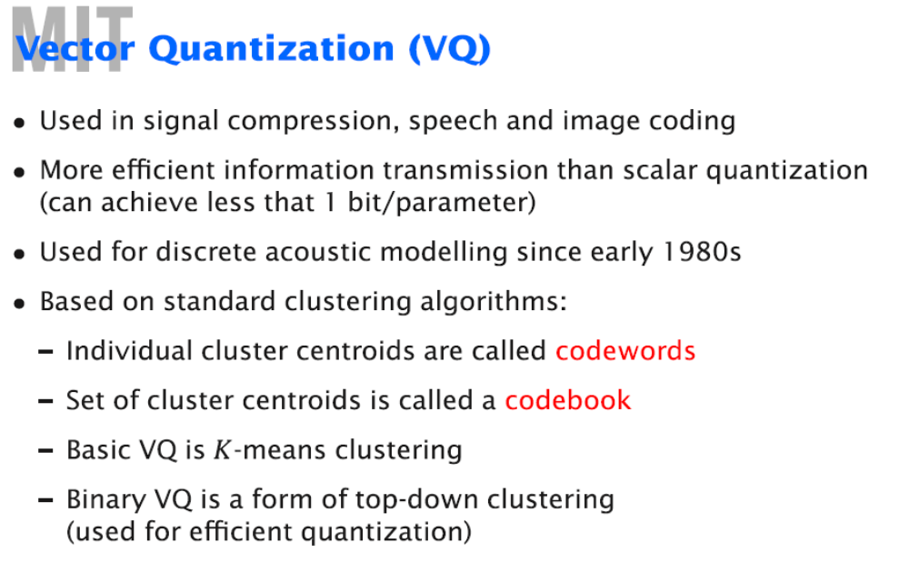
Vector Quantization in Speech Recognition - 2

Slide 41
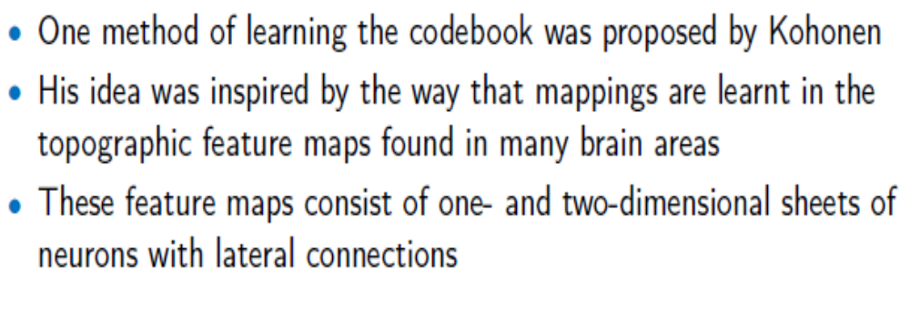
Self-Organization Feature Map (SOM)

Slide 42
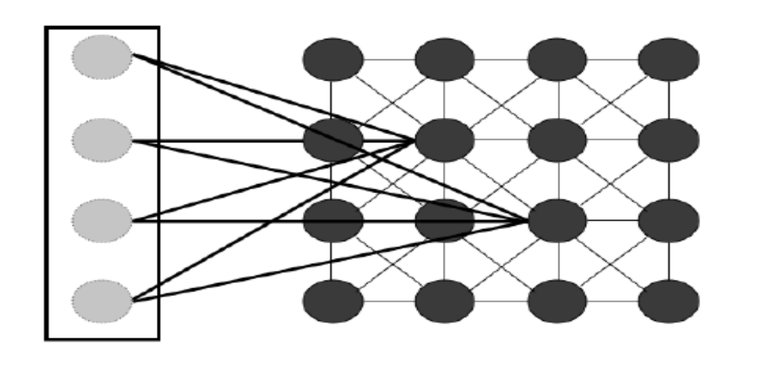
Self-Organization Feature Map
FIGURE 14.6 The Self-Organising Map network. As usual, input nodes (on the left) do no computation, and the weights are modified to change the activations of the neurons (weights are only shown to two nodes for clarity). However, the nodes within the SOM affect each other in that the winning node also changes the weights of neurons that are close to it. Connections are shown in the figure to the eight closest nodes, but this is a parameter of the network.

Slide 43
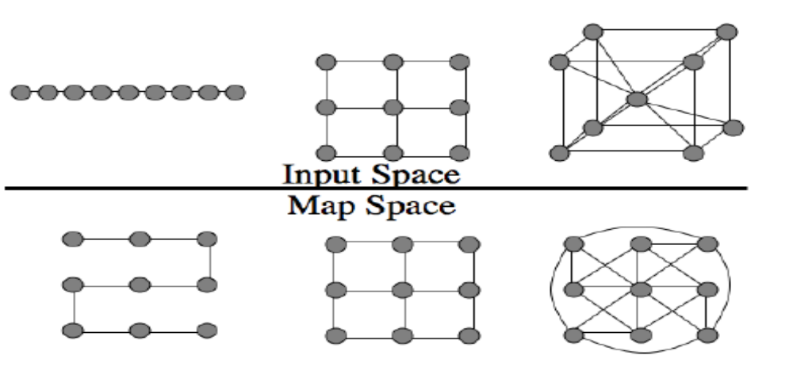
Topology Preservation in SOM
FIGURE 14.7 When inputs in 1D (a straight line), a 2D grid, and a 3D cube are represented by a 2D grid of neurons, the relative ordering is not perfectly preserved. The 1D line is bent, which means that points that used to be a long way apart (such as the first and sixth on the line) are now close together, while the cube becomes very complicated. The lines in the bottom part of the figure represent connections that are meant to be close.

Slide 44
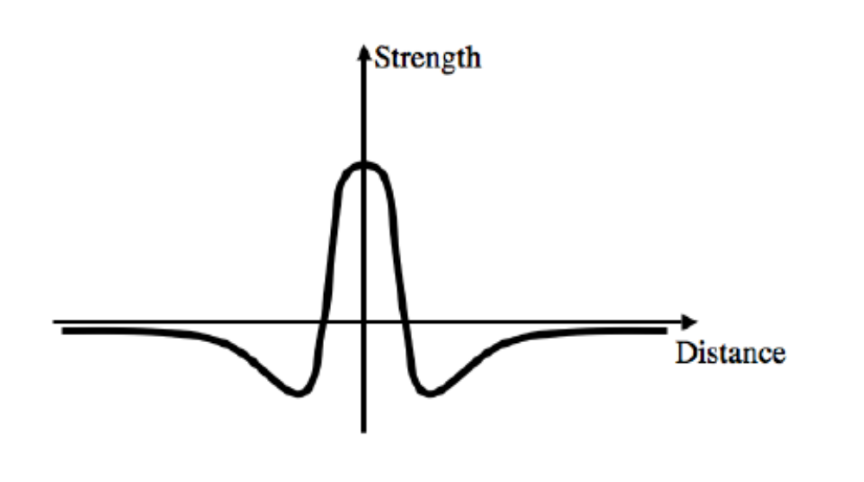
Neurons Connections
Mexican Hat

Slide 45
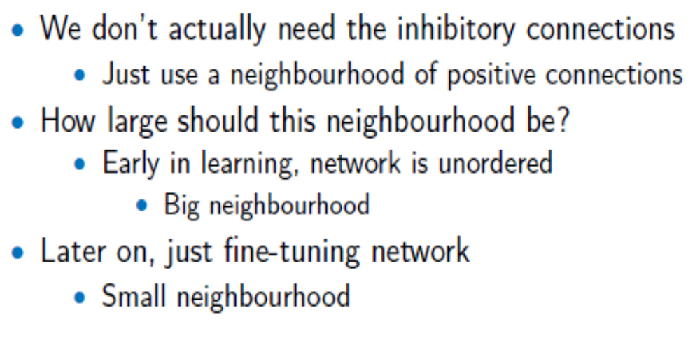
Neurons Connections

Slide 46
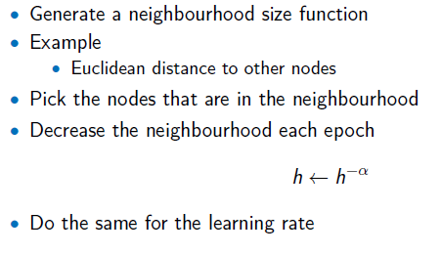
Neighbors

Slide 47
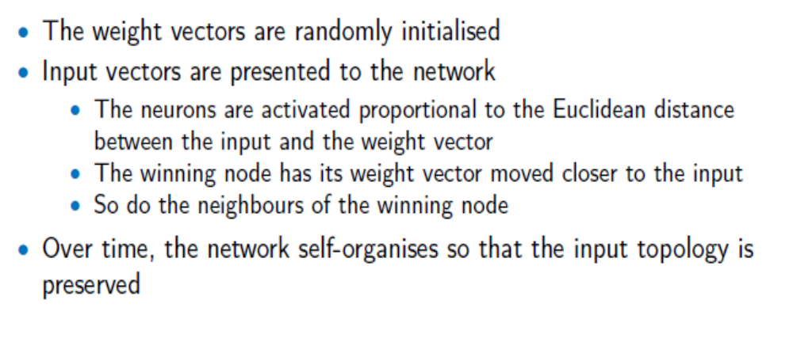
SOM – Algorithm Summary

Slide 48
SOM – Algorithm Equations - 1
Initialization – choose a size (number of neurons) and number of dimensions d for the map – either: * choose random values for the weight vectors so that they are all different OR
* set the weight values to increase in the direction
of the first d principal components of the dataset
Learning – repeat:
* for each data point: select the best-matching neuron n_{b} using the minimum Euclidean distance between the weights and the input,

Slide 49
SOM – Algorithm Equations - 2
update the weight vector of the best-matching node using:
update the weight vector of all other neurons using:
where η_{n}(t) is the learning rate for neighborhood nodes, and h(n_{b}, t) is the neighborhood function, which decides whether each neuron should be included in the neighborhood of the winning neuron (so h = 1 for neighbors and h = 0 for non-neighbors)

Slide 50
SOM – Algorithm Equations - 3
Reduce the learning rates and adjust the neighborhood function, typically by η(t + 1) = αη(t)^(k/kmax) where 0 ≤ α ≤ 1 decides how fast the size decreases, k is the number of iterations the algorithm has been running for, and kmax is when you want the learning to stop. The same equation is used for both learning rates (η, η_{n}) and the neighborhood function h(n_{b}, t).
- until the map stops changing or some maximum number of iterations is exceeded.

Slide 51
SOM – Algorithm Equations - 4
Usage – for each test point:
* select the best-matching neuron n_{b} using the
minimum Euclidean distance between the weights
and the input:

Slide 52
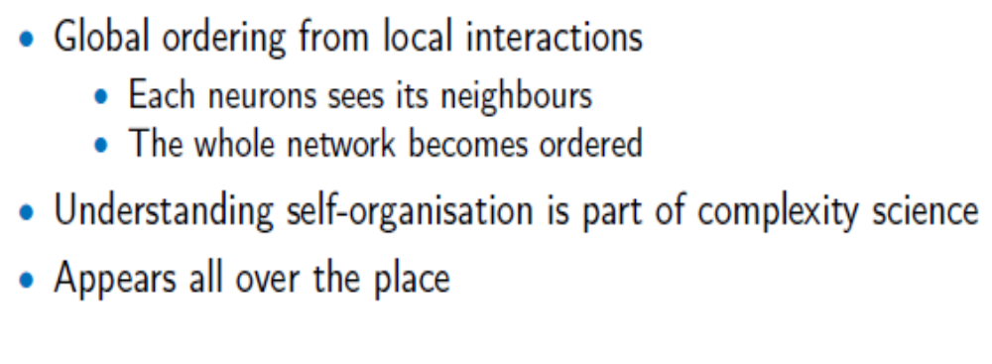
Self Organization Process

Slide 53
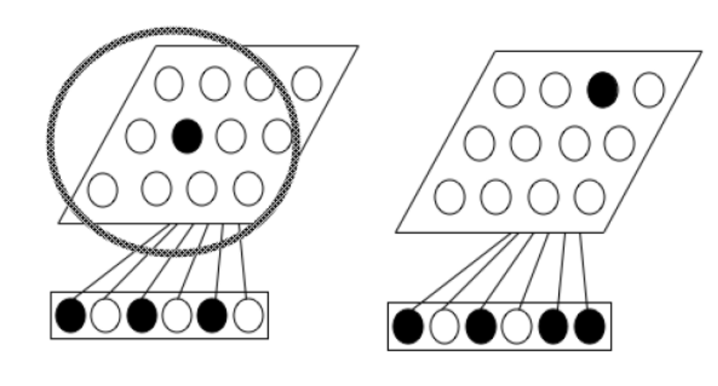
Self Organization Process
FIGURE 14.9 Top: Initially, similar input vectors excite neurons that are far apart, so that the neighbourhood (shown as a circle) needs to be large. Bottom: Later on during training the neighbourhood can be smaller, because similar input vectors excite neurons that are close together.

Slide 54
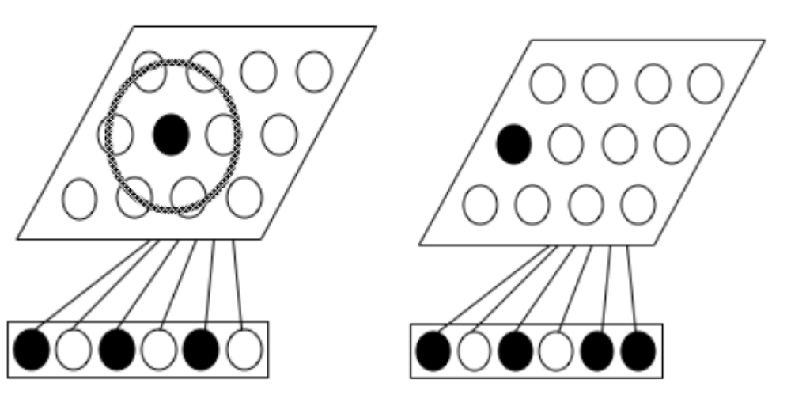
Self Organization Process

Slide 55
Boundary Conditions
We also need to consider the boundaries of the network. In some cases, it makes sense that the edges of the map of neurons is strictly defined — for example, if we are arranging sounds from low pitch to high pitch, then the lowest and highest pitches we can hear are obvious endpoints.
However, for many cases boundaries are not defined. In this case we might want to remove the boundary conditions. We can do this by removing the boundary by tying the ends together (next slide)

Slide 56
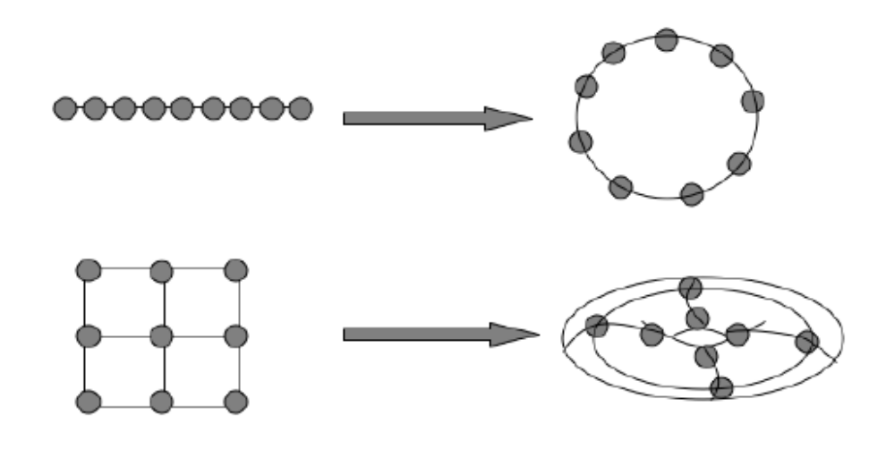
Boundary Conditions
When boundaries are removed
FIGURE 14.10 Using circular boundary conditions in 1D turns a line into a circle, while in 2D it turns a rectangle into a torus.

Slide 57
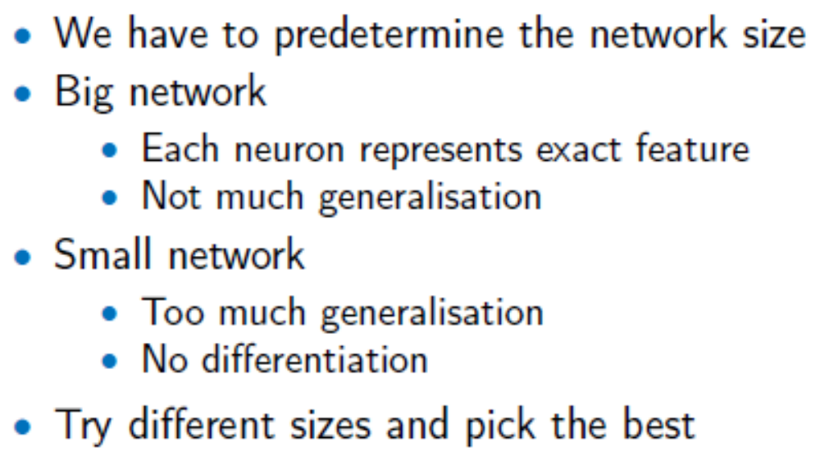
Network Size

Slide 58
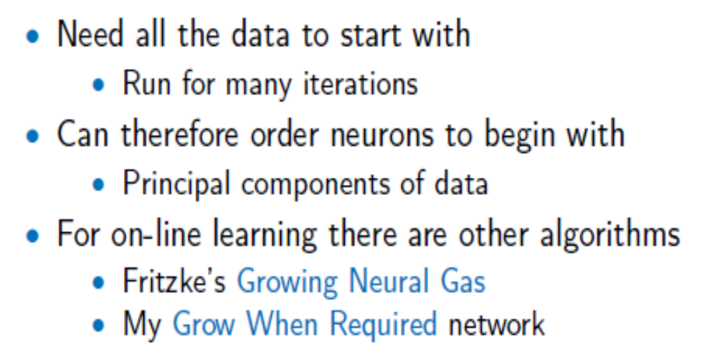
Batch Learning

Slide 59
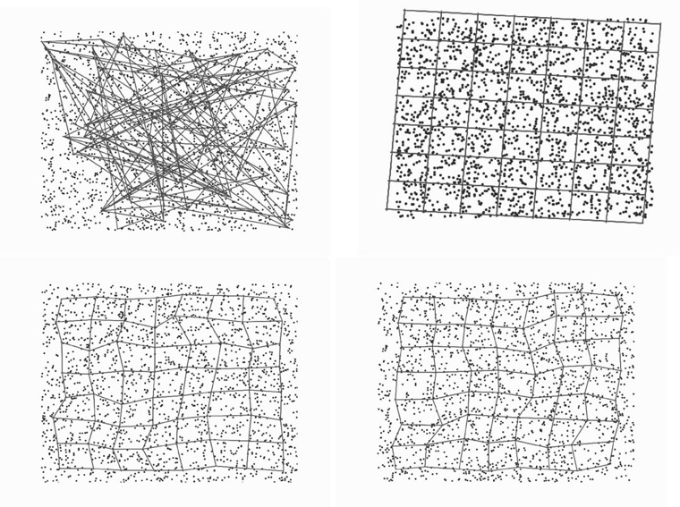
Example Using SOM
The Figure below shows Topological Ordering after a few cycles of training – Top: Initialization (L:with random weights, R: using PCA). Bottom – L: results after 10 iterations; R: After 5 iterations.

